Slide 1
Unifying Biology Education with Systems and Systems Thinking
Jenni Momsen, North Dakota State University
Elena Bray Speth, Saint Louis University
Sara Wyse, Bethel University
Tammy Long, Michigan State University

Slide 2
Why does biology need a unifying paradigm?

Slide 3
Why does biology need a unifying paradigm?
Provides structure
Supports instructional design, curriculum development
Helps learners organize their knowledge in meaningful ways
Bruner (1960); Nehm (2019)

Slide 4
Core concepts in Vision & Change

Slide 5
Core concepts in Vision & Change

Slide 6
Systems theory
Diverse roots
Biology - von Bertalanffy
Ecology - Odum & Odum
Management - Checkland
Organizational Learning - Senge
And many more!
Systems & Biology
As a discipline, biology is increasingly adopting a systems approach
A broad literature base describes systems thinking skills
Systems are
“[a] group of interacting or interrelated elements (...) forming a collective entity (Northrop, 2014, p 2)
“An entity that maintains its existence and functions as a whole through the interaction of its parts” (Ben-Zvi Assaraf and Orion, 2005, p 510)

Slide 7
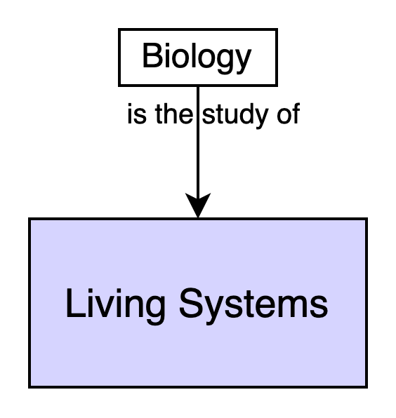
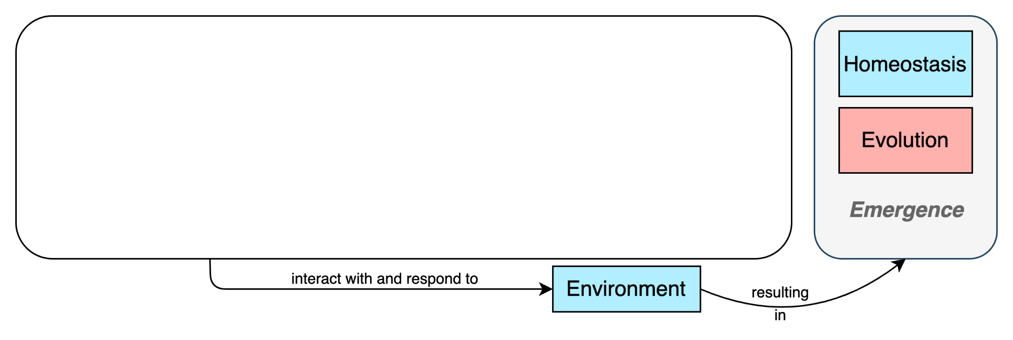
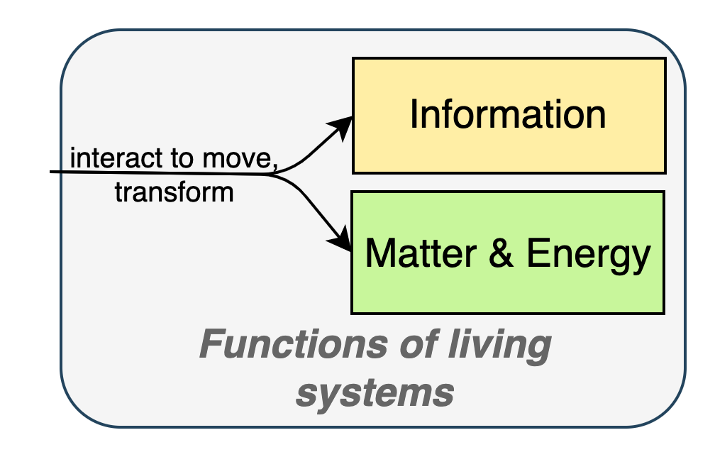
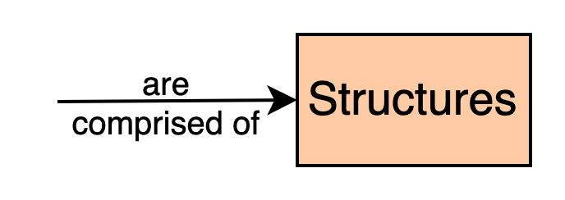
Systems as a paradigm to organize biology

Slide 8
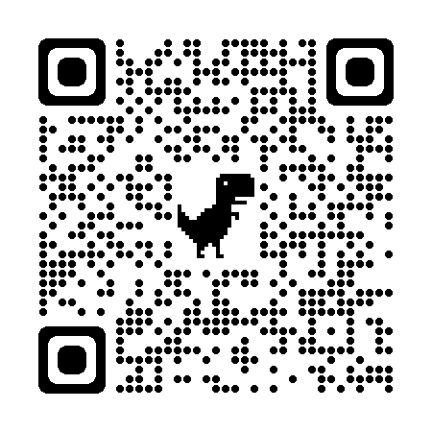
Supporting Instruction and Learning: The Biology Systems Thinking (BST) Framework
Momsen, J., Speth, E. B., Wyse, S., & Long, T. (2022). Using Systems and Systems Thinking to Unify Biology Education. CBE-Life Sciences Education, 21(2), es3.

Slide 9
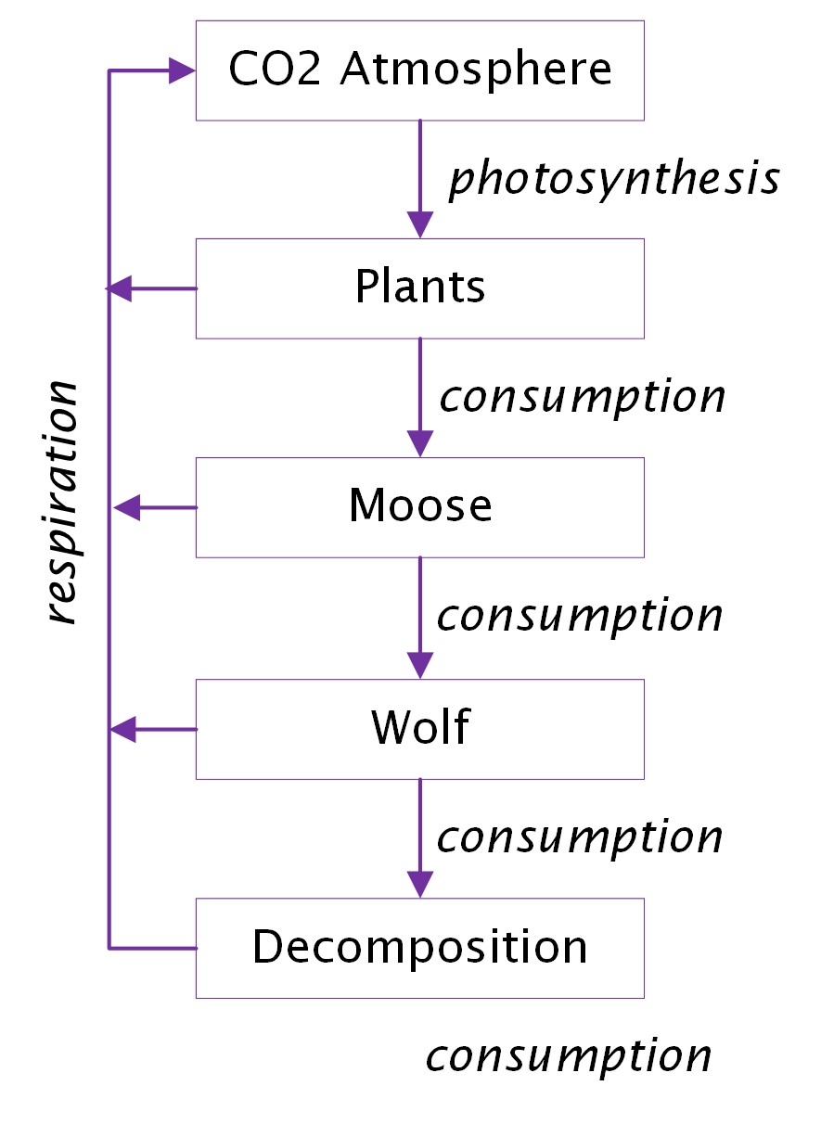
Development of the BST framework
General Systems Theory (von Bertalanffy)
Prior research on systems thinking
Ben-Zvi Assaraf and Orion (2005, 2010)
Sommer and Lücken (2010)
Structures
Behavior/ Relationship
SBF: A language describing systems (Goel and Chandrasekaran, 1989; Goel et al., 1996)
Function first language!
Function

Slide 10
Biology Systems Thinking (BST) Framework
Level 1
Identify and describe the system of interest
Level 2
Analyzing and reasoning about relationships
Level 3
Analyzing and reasoning about the whole system
Level 4
Reasoning across multiple systems

Slide 11
Level 1
Identify and describe the system of interest
Identify the structures and system boundaries relevant to the particular function.
Identify relationships among system structures relevant to a particular function.
Organize system structures and relationships to explain how the system accomplishes its function.
How do students demonstrate these skills?

Slide 12
Level 1
Identify and describe the system of interest
Typical task. Construct a model of [Function X] in [System Y].
Construct a model of carbon movement in Isle Royale.
atmosphere
wolf
atmosphere
photosynthesis
moose
detritivore
consumption
photosynthesis
respiration
balsam fir
balsam fir

Slide 13
Level 1
Identify and describe the system of interest
Typical task. Construct a model of [Function X] in [System Y].
Construct a model of carbon cycling in Isle Royale.

Slide 14
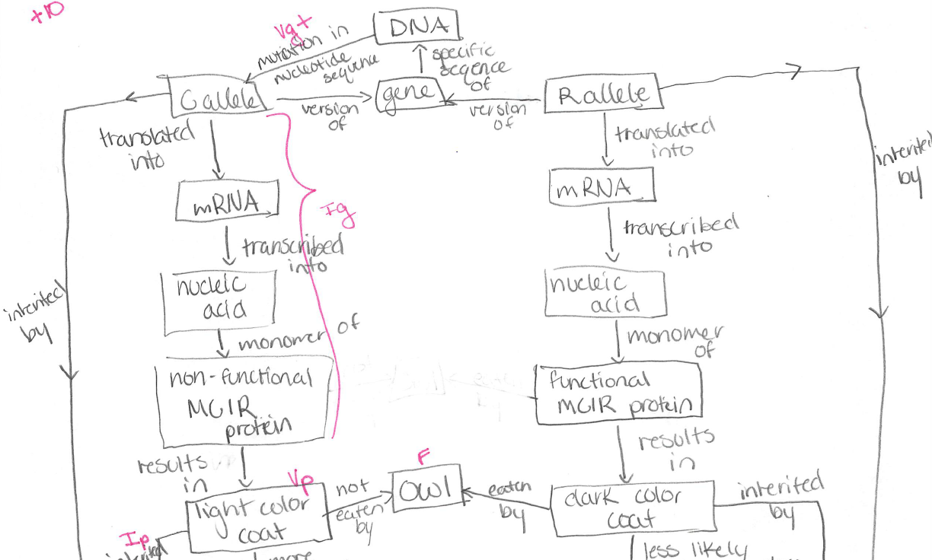
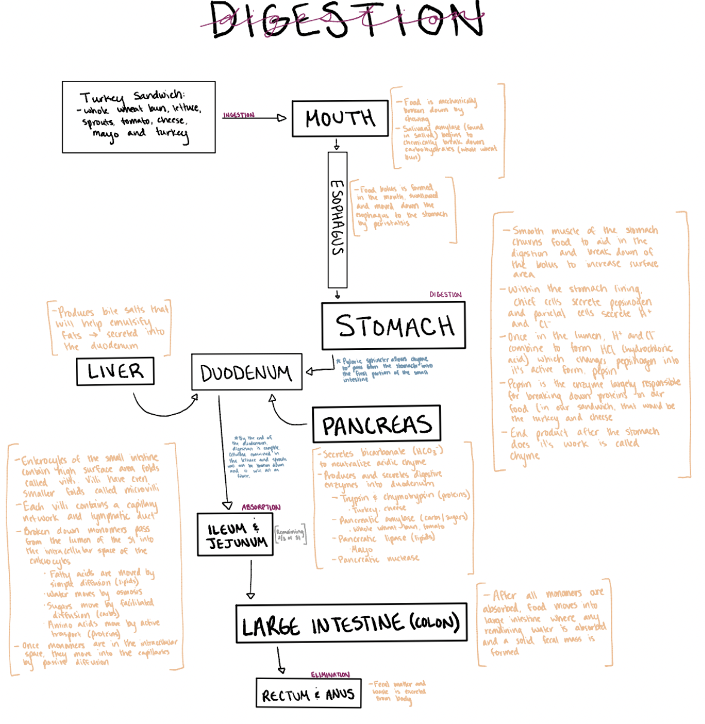
Level 1
Identify and describe the system of interest
Construct a model of phenotypic variation in beach mice.
Construct a model of how a human acquires and moves energy from the environment.

Slide 15
Level 1
Identify and describe the system of interest
Typical task. Construct a model of [Function X] in [System Y]
Alternative tasks
1a: Make a list of the structures that are most relevant for explaining [a given system function]
1b: Write a short sentence or phrase that describes how each pair of structures are related to each other
1c: Explain how [system] performs [function]

Slide 16
Level 2
Analyzing and reasoning about relationships
Characterize the qualitative nature of relationships (e.g., structural, mechanistic, static, dynamic, within-scale or transcalar).
Reason about the quantitative (or relative quantitative) properties of relationships (e.g., speed, magnitude, rates of reactions).
Predict and explain direct effects of relationships on system structures (e.g., positive and negative impacts of one structure on another).
How do students demonstrate these skills?

Slide 17
Level 2
Analyzing and reasoning about relationships
Isle Royale
Level 2c. Predict and explain direct effects
Predict the impact of wolf extirpation on the moose population. Briefly explain your reasoning.
In the winter of 2015, the wolf population was estimated at 3 individuals. Biologists believe the wolf population in Isle Royale will soon be extirpated (locally extinct).

Slide 18
Level 3
Analyzing and reasoning about the whole system
Analyze a system to describe indirect effects and feedback loops (both negative and positive).
Explain emergent biological phenomena based on broad principles of biology and on knowledge and understanding of specific properties of systems.
Predict and explain consequences to system function resulting from changes to system boundaries, structures, or relationships (perturbations or disturbances, rate changes of dynamic processes, feedback, etc.).
How do students demonstrate these skills?

Slide 19
Level 3
Analyzing and reasoning about the whole system
In the winter of 2015, the wolf population was estimated at 3 individuals. Biologists believe the wolf population in Isle Royale will soon be extirpated (locally extinct).
Isle Royale
Level 3a. Predict and explain indirect effects
Predict the impact of wolf extirpation on the fir tree population. Briefly explain your reasoning.
Level 3c. Predict and explain consequences of perturbations
How might the loss of wolves impact the movement and storage of carbon in the Isle Royale ecosystem?

Slide 20
Level 4
Reasoning across multiple systems
Recognize patterns across systems in order to make generalizations about systems with similar underlying structure or function.
Identify how systems intersect in order to explain the ways that one system’s function can impact another system at the same level of biological organization.
Identify how systems intersect in order to explain the ways that one system’s function can impact another system across biological levels of organization.
How do students demonstrate these skills?

Slide 21
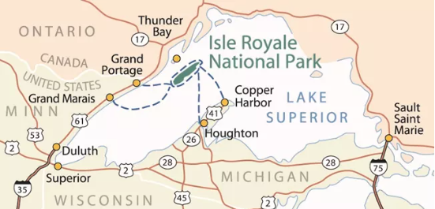
Level 4
Reasoning across multiple systems
Isle Royale
Isle Royale is surrounded by Lake Superior.
Level 1a, b, c. Identify and organize system components, relationships
Construct a model describing how carbon moves through Lake Superior.
Level 4a. Recognize patterns across systems
Briefly compare and contrast carbon movement in these two systems.

Slide 22
Systems & ST as paradigm for instruction

Slide 23
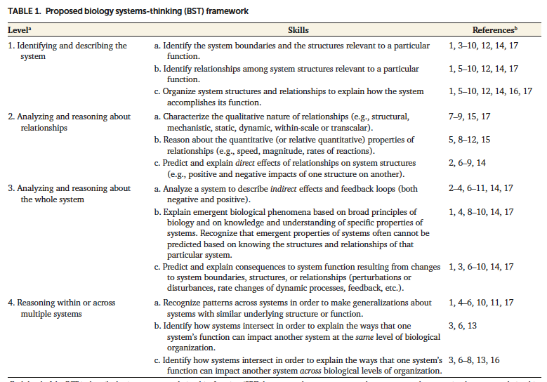
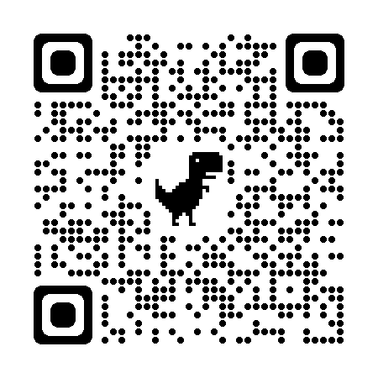
Translating into practice
https://sites.google.com/slu.edu/systems-and-st-in-biology/
Momsen et al (2022)

Slide 24
Systems and Systems Thinking in Biology Education
https://sites.google.com/slu.edu/systems-and-st-in-biology/

Slide 25
Systems and Systems Thinking in Biology Education
https://sites.google.com/slu.edu/systems-and-st-in-biology/

Slide 26
Systems and Systems Thinking in Biology Education
Cells use information encoded in genes to produce mRNA molecules and proteins.
identify the physical structures (molecules) relevant to explain how genes are expressed in cells (BST1.a);
identify the relationships among these cellular and molecular structures (BST1.b);
organize system structures and relationships to explain how genes are expressed in cells (BST 1.c).
https://sites.google.com/slu.edu/systems-and-st-in-biology/

Slide 27
Systems and Systems Thinking in Biology Education
https://sites.google.com/slu.edu/systems-and-st-in-biology/

Slide 28
What’s next for the BST?!
Framework validation – in progress! (we have a survey we’d love folks to share with colleagues!)
Describe how learners develop ST skills
Explore how a systems and ST paradigm could transform curriculum
Identify instruction and assessments that promote skill development
Crowd sourcing! We would love your examples of assessments that target ST skills in a variety of contexts (functions and systems) and courses (intro to capstone!)

Slide 29
Website with teaching resources
Our paper
This material based on work supported by the National Science Foundation under Grants DUE-2012208 and DRL-1420321
Interested in more? Maybe a workshop? Contact us:
Sara Wyse: s-wyse@bethel.edu
Jenni Momsen: jennifer.momsen@ndsu.edu
Many thanks to Tara Slominski, Steve Bennett, Amanda Sebesta, Caitlin Anderson, Seth Hunt, and Bethany Gettings

