Slide 1
(Re)designing a Large Foundational Biology Course Around Active Learning
Curriculum Committee:
Dr. Gidi Shemer
Dr. Kelly Hogan
Dr. Keith Sockman
Dr. Zach Nimchuk
EEOB Foundations Sub-Committee
Dr. Allen Hurlbert
Dr. Chris Willett
Dr. Cathy Lohmann
Dr. Todd Vision
Dr. Lillian Zwemer
Assessment Committee
Dr. Laura Ott (Chair)
Dr. Alaina Garland
Dr. Eric Hastie
Dr. Mark Pfeiffer
Dr. Allen Hurlbert
Dr. Steve Rogers
Dr. Mara Evans, PhD (she/her)
STEM Teaching Associate Professor
Biology Department
University of North Carolina, Chapel Hill
2024

Slide 2
Goal: Curriculum Revision + Course (re)Design →Lessons we learned along the way
Use a data-driven approach to identify areas of change.
It will take time! Plan ahead.
It will take resources! Plan ahead.
It will take deliberate and repetitive communication.
Employ all the talents of scientific thinking
Propose a hypothesis
Consider your variables – what will you measure and how?
Plan to iterate at different scales

Slide 3
What did we aim to accomplish?
Revise 40-year-old biology curriculum using the guidance of Vision and Change (AAAS, 2011)
Core competencies (skills)
Core concepts
Propose and implement changes that:
Reduce bottlenecks for graduation
Provide scaffolding for student skill and knowledge development
Reduced non-biology credit requirements to maximize personal choice
Reduced co-teaching burdens → more efficient use of teaching resources!
Are measurable

Slide 4
A look back: Timeline to revisions to BS degree
Motion to change chemistry requirements
Discuss merits of biology curriculum models and produce a comprehensive proposal for expected change and implementation
Discuss proposed changes to non-biology parts of curriculum
Presentation of biology curriculum models
University
approval
process
Implementation
April 2019
May 2019
Fall 2019/Spring 2020
Fall 2020/
Spring 2021
Fall 2021
Notes:
Non-biology parts of curriculum include chemistry requirements, physics and quantitative reasoning (QR)

Slide 5
A look back: Timeline to revisions
Motion to change chemistry requirements
Discuss merits of biology curriculum models and produce a comprehensive proposal for expected change and implementation
Discussed proposed changes to non-biology parts of curriculum
Presentation of biology curriculum models
University
approval
process
Implementation
April 2019
May 2019
Fall 2019/Spring 2020
Fall 2020/
Spring 2021
Fall 2021
Delayed
Fall 2022
Notes:
Non-biology parts of curriculum include chemistry requirements, physics and quantitative reasoning (QR)

Slide 6
Old UNC biology BS curriculum (biology classes)
(Mandatory /AP)
BIOL 101
(4 Mandatory classes (and lab)- can take them anytime)
BIOL 201
Ecology and Evolution
Organismal/L
BIOL 202
Molecular Biology and Genetics
BIOL 205
Cellular and Developmental Bio
(potential A&P)
(+) Successful biology students graduate from UNC.
(-) Core classes are very broad and deep relative to personal biological interest.
(-) Curricular path means students often discover biological interests too close to graduation.
4 Electives (2≥ 400; 2 w/L)
Notes:
The current biology curriculum:
All students are required to take BIOL 101 but most place out with AP credit (or IB or transfer)
Students take total of four mandatory classes, three of them we know as the “core classes” and the fourth is organismal biology with a lab.
The three core classes are depicted in this diagram in this manner because they cover material at great width and depth.
Students are permitted to take these required classes at any time before graduation.
In addition to the core biology classes students take four electives, 2 are greater or equal to 400 level classes and 2 with labs.
What I’d like to do you know is share the observations the committee has made about the current biology curriculum to inform you all of the challenges and opportunities we face. (talk through Organismal/L challenges) These observations come from work done by the previous, larger bio-curriculum committee, formal and informal data gathering from students, data about course enrollment and conversations with faculty.

Slide 7
New Tier Model – biology classes
(Mandatory /AP)
101
Skills: Tier 1
-Scientific thinking
-Interpret data
-Collaborate
(3 Mandatory- must be taken first, no AP credit will substitute)
BIOL 103 – How Cells Work
Fundamentals of
Mol. & Cell. Biology
BIOL 105 – Lab Skills
BIOL 104 - Biodiversity
Fundamentals of EEOB
Skills: Tier 2
Critically evaluate scientific data and scientific literature
BIOL 220
Genetics
BIOL 250
Evolution
A&P 1
Mix or
Pair
(at least 2)
Mix or
Pair
(at least 2)
BIOL 240
Cell Bio
BIOL 260 Ecology
AP2/micro/neuro
4 Electives (2 ≥ 400; 2 w/L)- can be taken from Tier 2 alternate paths or from all other courses
Skills: Tier 3
Communicate effectively about science, both orally and in writing, to diverse audiences
Notes:
We are using names and numbers here merely as place holders
Tier 1: classes focus on the fundamentals are not as deep as current core classes but focus on key skills and core concepts. Must be take first.
In the second tier we are showing you six possible classes, but we may find that far more are appropriate at this tier. You can imagine a scenario where students might couple their selection based on areas of concentration. The key here is that these “new” classes would be more focused, allow for more depth of exploration (content and skill)
In the third tier, we’ve arrived at more advanced classes.
This model expects more connectivity between classes

Slide 8
BIOL 104: Biodiversity
Typical class size: 200 people (multiple sections/year)
High-structured class; active learning; large and small formative assessments
Teaching team: grader(s) + peer instructors in class
It is NOT a march through the Tree of Life.
Units (15-week term)
What is biodiversity (and how do we measure it)?
How does biodiversity arise?
What limits biodiversity?
How does biodiversity change?
Overarching: Why does biodiversity matter?
Course Syllabus and Learning Objectives will be provided at the end!

Slide 9
10 Course Goals and Learning Outcomes
Understand the different ways in which biodiversity is described and measured.
Describe historic and present patterns in the distribution and variety of life.
Understand how the scientific process is used to create knowledge about historic, complex, and dynamic systems that exist at various spatial and temporal scales.
Compare evolutionary theory with non-scientific ideas about the origins of biodiversity.
Apply frameworks to organize the understanding of the natural world (e.g., phylogenetics).
Describe and explain how organismal features-- like physiology, anatomy, and behavior-- are shaped by evolutionary and ecological forces through historical processes, including interactions within and between species and the environment.
Explain how the properties of Earth contribute to patterns of biodiversity.
Explain the abiotic factors such energy and nutrients and biotic forces such as competition, predation/disease, and symbiosis, that limit population size, genetic diversity and species diversity in space and time.
Identify how disturbance (both natural and human caused) affects biodiversity over different spatial and temporal scales.
Apply knowledge of ecological and evolutionary principles to challenges in maintaining the health of human and natural systems and understand the biological impacts of human derived climate change.

Slide 10
Challenges / Opportunities
Nearly 80% of incoming first year students identify as preparing for a pre-healthcare related career (professional school or research).
Opportunity to teach about ‘one health’
Opportunity to teach about ecosystem services
Opportunity to teach about SIR models
Opportunity to teach about evolutionary medicine and human evolution
New curriculum format means it is *possible* (but unlikely) that BIOL 104 is students’ only ecology/evolution/organismal class.
Opportunity to teach about importance of applied science → conservation!
Class does not have a lab or recitation
Opportunity to incorporate Citizen Science (iNaturalist field work)

Slide 11
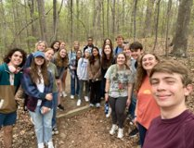
BIOL 104 Lesson Learning Cycle
Before
Readings and Guided Reading Questions (GRQs)
SimBio Products
In class
Active learning
Experimental design / analysis
After
Lesson quiz
Group work
North Carolina Natural History Project– iNaturalist Data Collection
Part 1: Read – Identification Quiz – Plant or Fungus Samples -- Reflection
Part 2: Read – Identification Quiz – Invertebrate Samples -- Reflection
Part 3: Read – Identification Quiz – Vertebrate Samples -- Reflection

Slide 12
BIOL 104: Sample Lesson – Food Webs
Review with peer instructor(s)
Lesson Quiz
Before Class
In Class
After Class →
Lesson Objectives
Explain the factors that limit the size of a food chain
Explain the difference between a dominant species and a keystone species
Use a food web diagram to identify both direct and indirect species interactions.
Explain the role of keystone species in trophic cascades.
Interpret experimental results to determine top-down vs. bottom-up effects in trophic interactions.
Read Community Dynamics Sections 2 and 3 (SimBio)
Do embedded questions (not graded)
Watch Video: “How Wolves Change Rivers”
Complete Guided Reading Questions (GRQs) for credit (Gradescope)
Download lesson outline
Notes:
Unit 3 – what limits biodiversity?

Slide 13
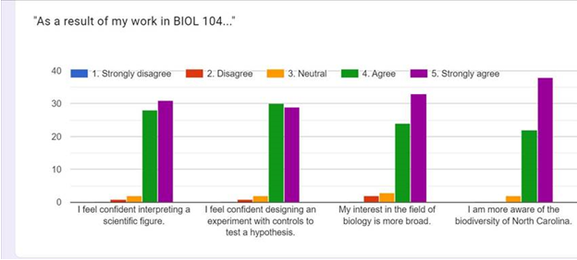
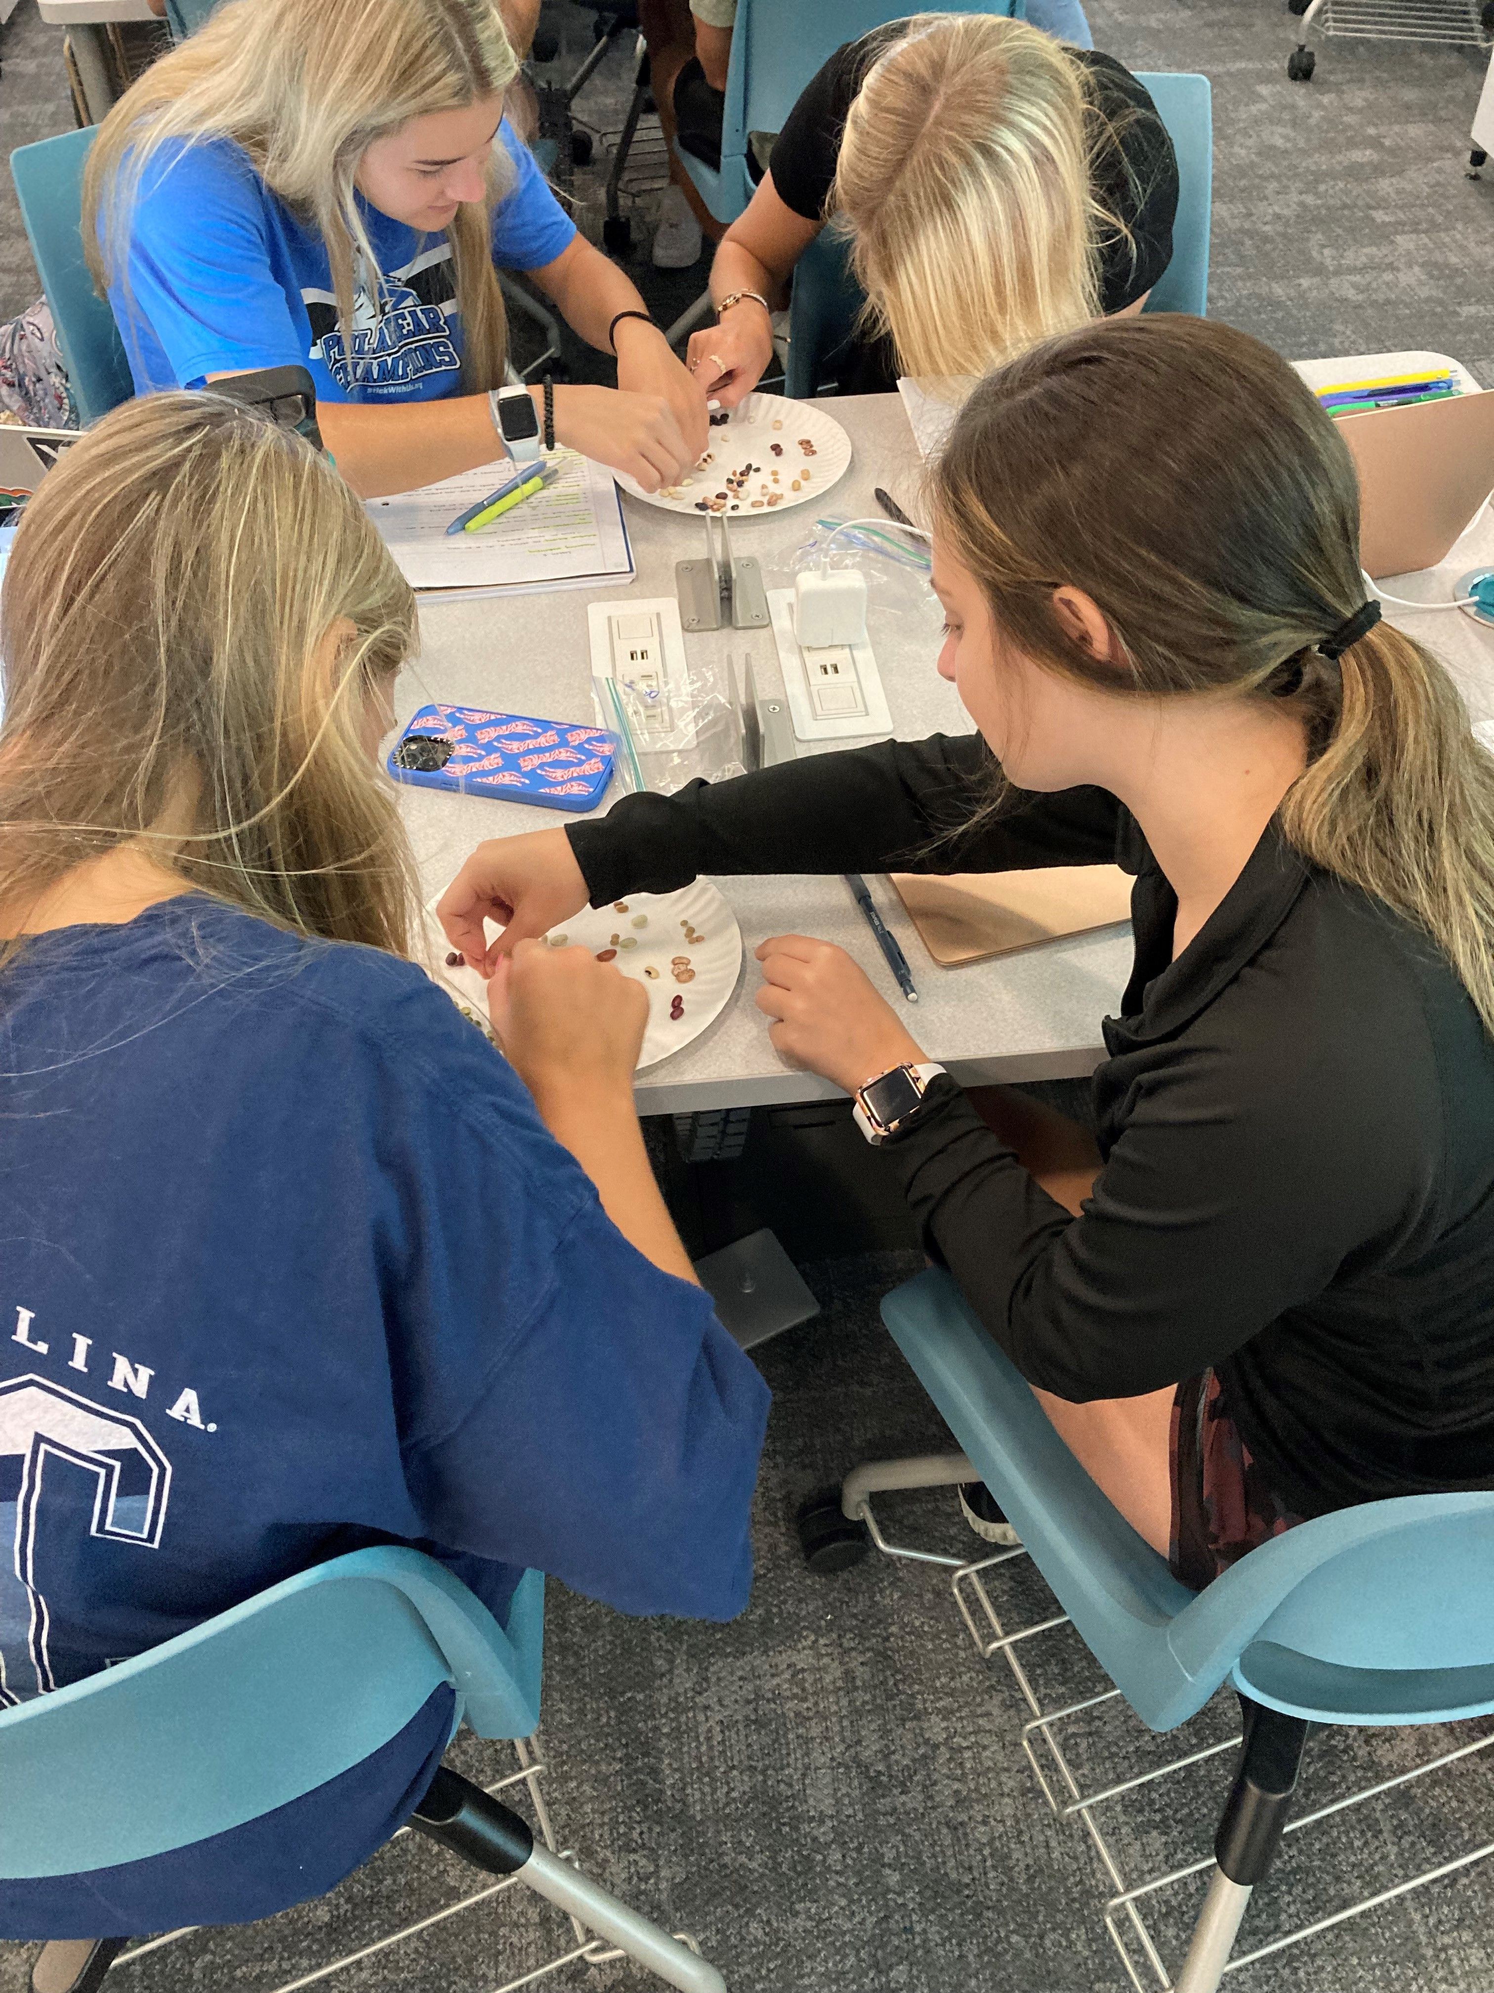
BIOL 104 Year 1 Successes
Successfully implemented the class
Students performed well on high-order assessments
Positive feedback from students
N= 63 responding

Slide 14
BIOL 104: Opportunities for Improvement
Still identifying supplemental resources.
Does focusing on place-based biodiversity as a unifying theme in introductory biology impact student ecological attitudes?
Continue to evaluate assessment: balance between low and high stakes assignments.
Meeting enrollment needs.
Across 103/104/105 sequence: Determine order and combination of classes.
Using Bio-MAPS as a longitudinal assessment tool of learning gains

Slide 15
Lessons we learned along the way
Use a data-driven approach to identify areas of change
It will take time! → Consider paid support staff?
It will take resources!
How will you pay for course planning? (time or money?)
Do you have the capacity to teach “old” and “new” classes simultaneously?
Be Deliberately Inclusive: get many voices involved repeatedly.
Other majors who depend on your classes
Community Colleges teaching equivalent courses
Employ all the talents of scientific thinking
Make an assessment plan → consider resource needs!

Slide 16
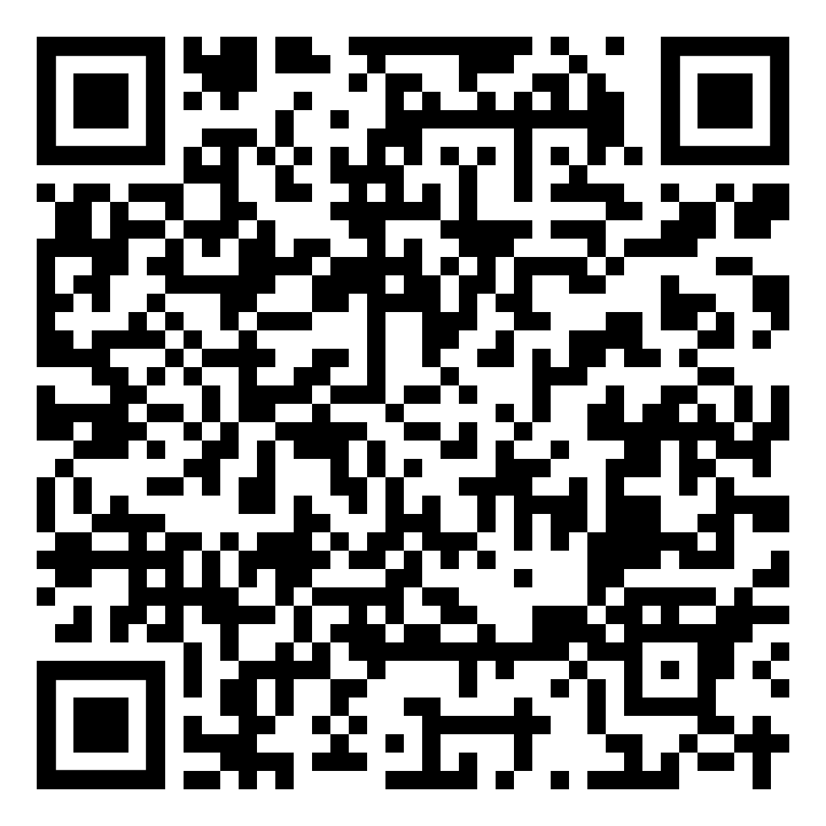
QR Code for Syllabus and Lesson Objectives
Dr. Mara Evans, PhD (she/her)
mara1@email.unc.edu
Biology Department
University of North Carolina, Chapel Hill

