Slide 1
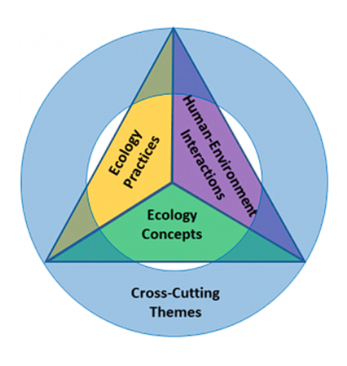
Teaching Ecology the ESA way: Using the 4DEE framework to guide active learning in ecology classes
Dr. Justin R. St. Juliana
Department of Ecology and Evolutionary Biology
Cornell University
Learning Objectives:
Know Dimensions of the 4DEE framework.
Understand the 4DEE framework.
Consider how active learning can be used to increase the coverage of 4DEE related learning objectives in the classroom.
Consider how resources like (SimUText) can be used to actively cover 4DEE related learning objectives outside the classroom before and after lecture.
Engage in a discussion at the intersection of: 4DEE, active learning, and course resources.

Slide 2
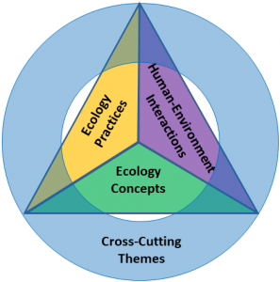
How familiar are you with 4DEE?
1 Not at all familiar
2
3
4
5 Very Familiar

Slide 3
4DEE Ecology Education Framework 21 Elements among 4 Dimensions
Core Ecology Concepts
classical ecological hierarchy
e.g., population, ecosystem
Ecology Practices
doing and critiquing ecology
e.g., fieldwork, modeling
Human-Environment Interactions
human dependency and impact
e.g., climate change, services, ethics
Cross-Cutting Themes
ways-of-thinking, unifying ideas
e.g., evolution, space, structure/
function
Notes:
Luanna

Slide 4
4DEE Ecology Education Framework 21 Elements among 4 Dimensions
Core Ecology Concepts
Organisms
Populations
Communities
Ecosystems
Landscapes
Biomes
Biosphere
Notes:
Luanna

Slide 5
4DEE Ecology Education Framework 21 Elements among 4 Dimensions
Ecology Practices
Natural history
Fieldwork
Quantitative reasoning and computational thinking
Designing and critiquing investigations
Working collaboratively
Communicating and applying ecology
Notes:
Luanna

Slide 6
4DEE Ecology Education Framework 21 Elements among 4 Dimensions
Human-Environment Interactions
Human dependence on the environment
Human accelerated environmental change
How humans shape and manage resources/ecosystems/the environment
Ethics
Notes:
Luanna

Slide 7
4DEE Ecology Education Framework 21 Elements among 4 Dimensions
Cross-Cutting Themes
Structure & Function
Pathways & Transformations of Matter and energy
Systems
Spatial & Temporal
Scales
Stability & change
Evolution
Biogeography
Notes:
Luanna

Slide 8
4DEE Ecology Education Framework 21 Elements among 4 Dimensions
Core Ecology Concepts
classical ecological hierarchy
e.g., population, ecosystem
Ecology Practices
doing and critiquing ecology
e.g., fieldwork, modeling
Human-Environment Interactions
human dependency and impact
e.g., climate change, services, ethics
Cross-Cutting Themes
ways-of-thinking, unifying ideas
e.g., evolution, space, structure/
function
Notes:
Luanna

Slide 9
4DEE & Active Learning in Lecture

Slide 10
The Four Dimensional Ecology Education (4DEE) Framework
Which of the 4DEE dimensions do you most closely associate with lecture?

Slide 11
The Four Dimensional Ecology Education (4DEE) Framework
Lecture

Slide 12
The Four Dimensional Ecology Education (4DEE) Framework
Lecture

Slide 13
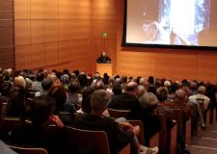
What adjectives do you think of when you think of traditional lectures?
Type your thoughts.

Slide 14
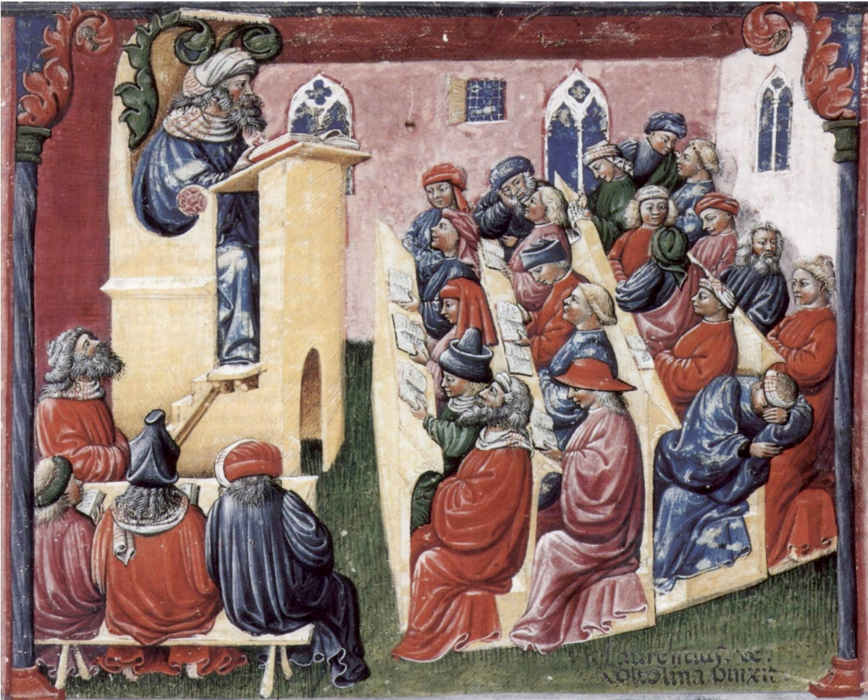
What is Active Learning in Lectures?
Notes:
Sage on the stage, stand and deliver, direct instruction, chalk and talk at.

Slide 15
What is Active Learning in Lectures?
Notes:
Sage on the stage, stand and deliver, direct instruction, chalk and talk at.

Slide 16
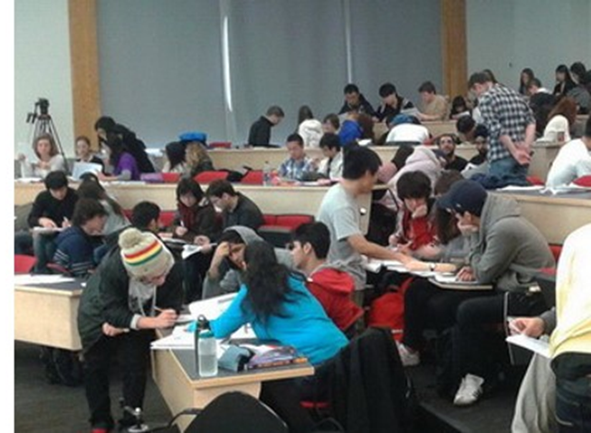
Passive learning vs Active Learning
There are many ways to implement active learning.

Slide 17
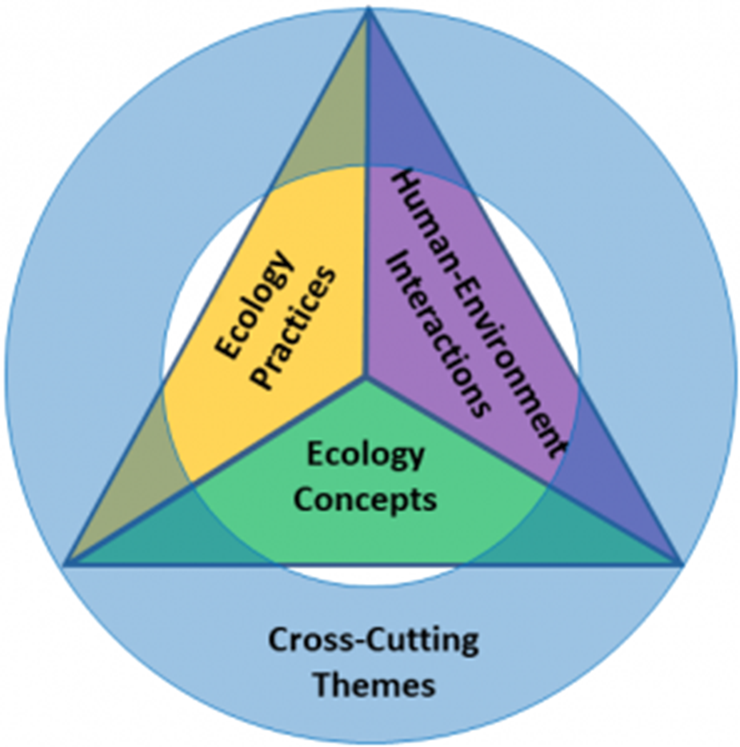
Pe
Pedagogy

Slide 18
The Four Dimensional Ecology Education (4DEE) Framework
Lecture
Active Learning
Active Learning

Slide 19
BioEE 1610: Ecology and The Environment
~250-350 students per semester
Mix of majors and non-majors
20% Ecology or Environment & Sustainability
15% Biology
15% Other STEM
50% 30+ other majors
2 50 min. lectures per week
1 50 min. discussion section per week

Slide 20
About Activities
Practice ->
Use a student response system
5-14 Active events per lecture
Activities range from 1 to 10min.
Almost every activity involves students talking to each other prior to answering

Slide 21
About Activities
Practice ->
Use a student response system
5-14 Active events per lecture
Activities range from 1 to 10min.
Almost every activity involves students talking to each other prior to answering
Philosophy ->
Formative questions
Try to make most questions charismatic and student oriented
Students are only awarded participation points
Allows room for creativity, and a positive learning environment
Many questions have no correct answer

Slide 22
About the lecture
Use a student response system (Poll Everywhere, iClickers, etc.)
We use community based active learning
Use regional seating

Slide 23
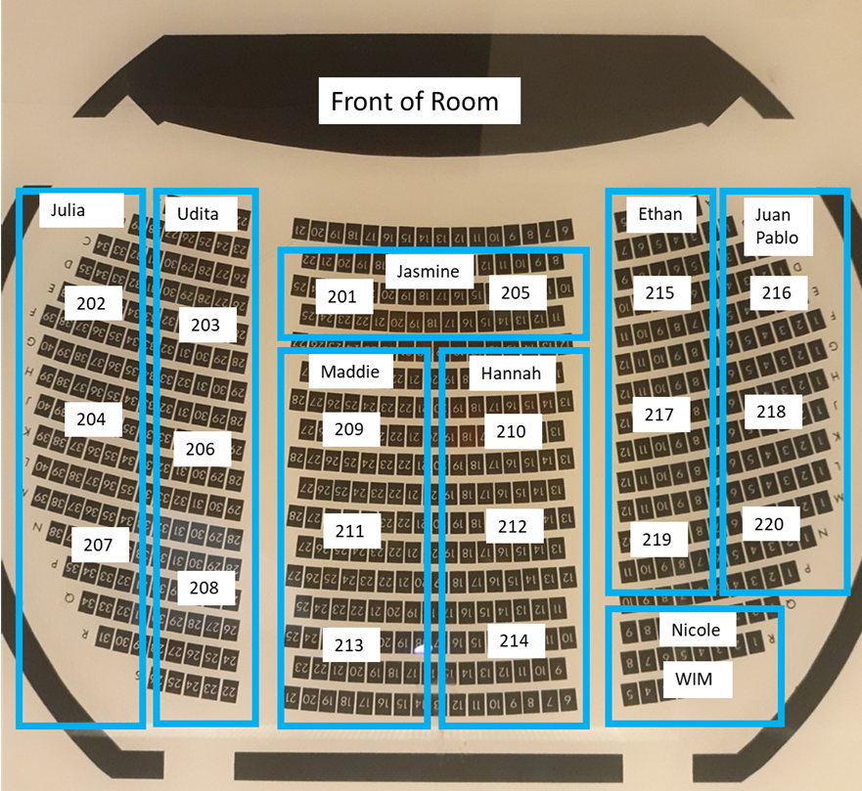
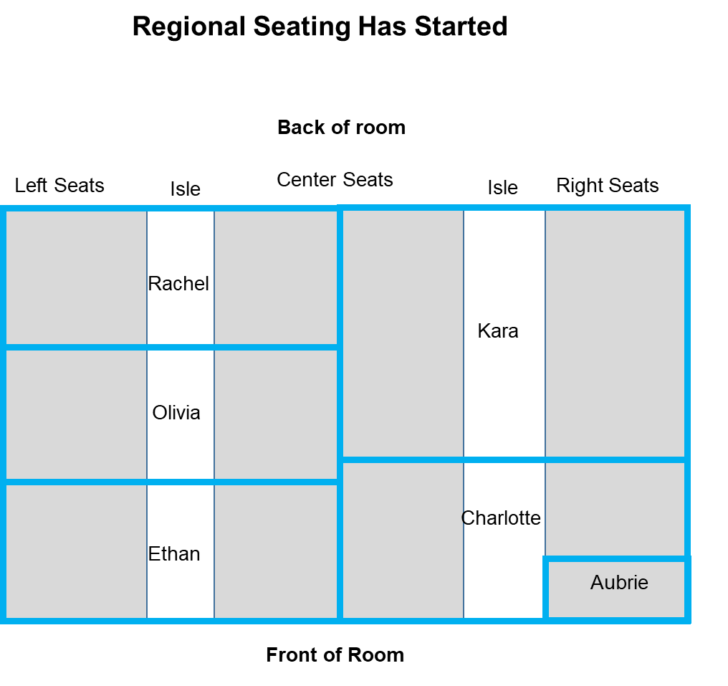
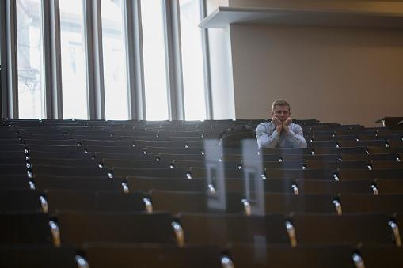
About the lecture
Use a student response system (Poll Everywhere, iClickers, etc.)
We use community based active learning
Use regional seating

Slide 24
About the lecture
Use a student response system (Poll Everywhere, iClickers, etc.)
We use community based active learning
Use regional seating
Students sit in a region of a room near students from their section and their TA
Students know somebody sitting near them
Students are more likely to participate
TAs better able to interact with students
Note: TAs stand and walk around, shifts tone
Students ask more questions
Students are held accountable by TAs

Slide 25
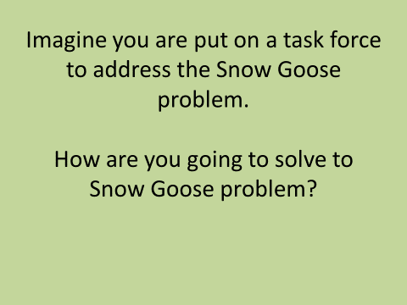
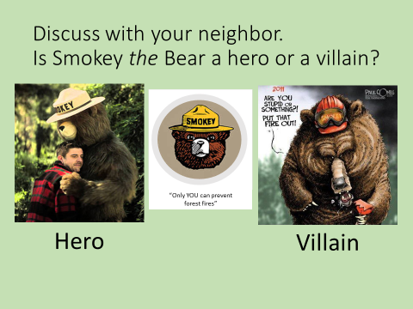
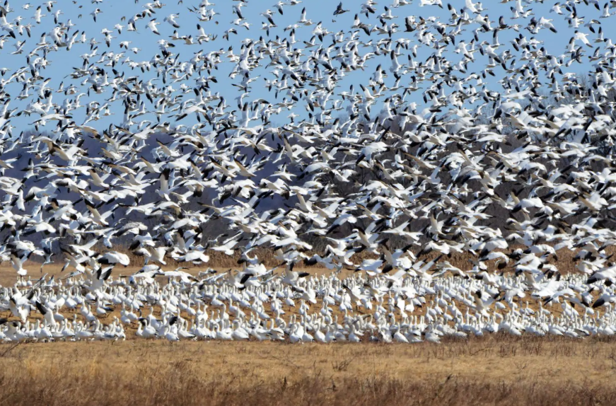
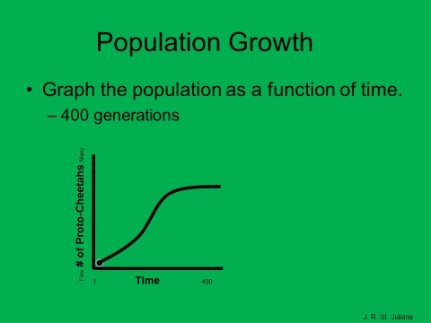
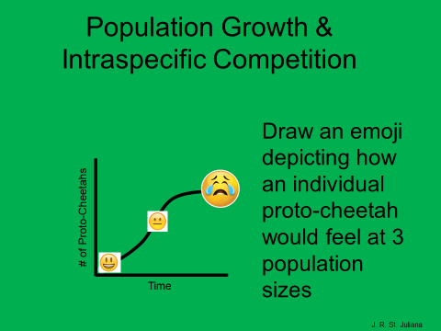
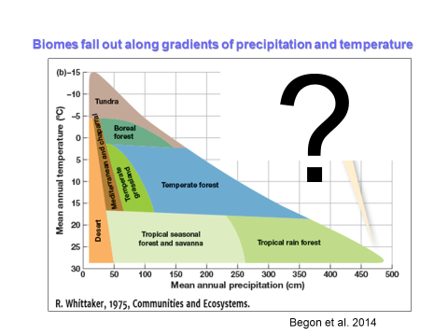
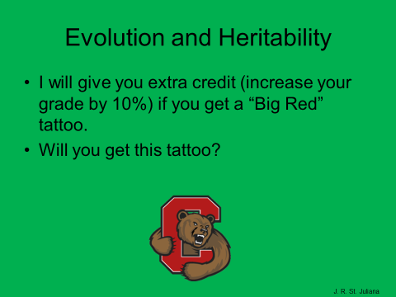
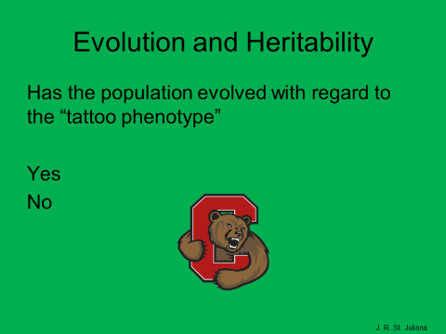
Example questions
III
I &III
I & III
I & II
I, II
IV
I, II & III
III

Slide 26
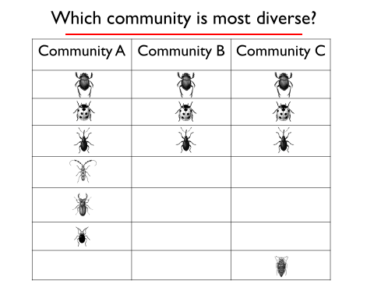
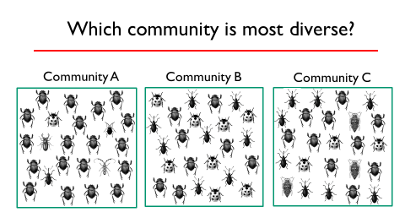
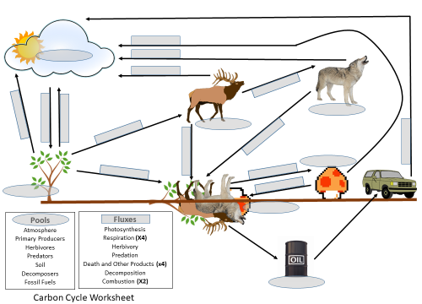
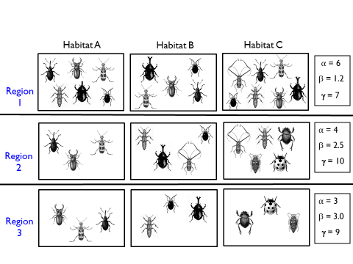
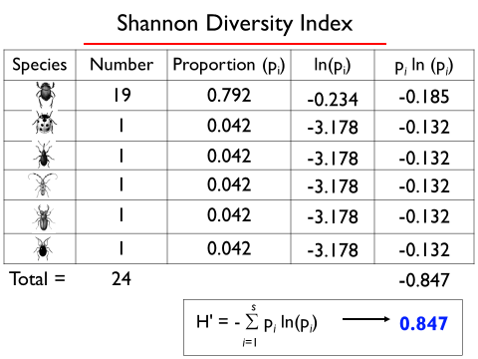
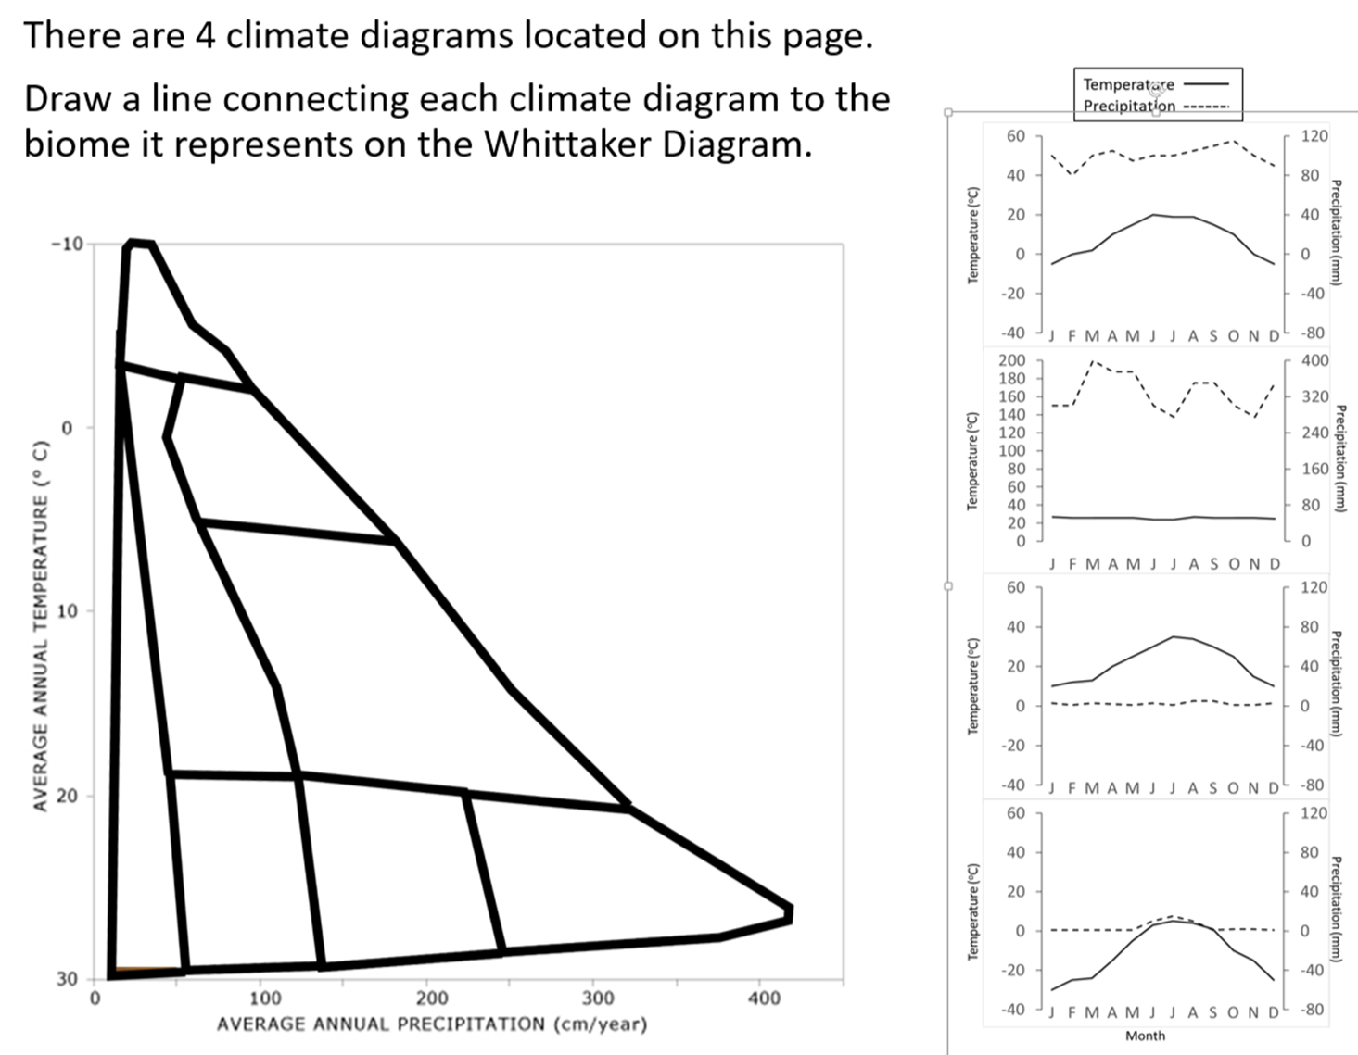
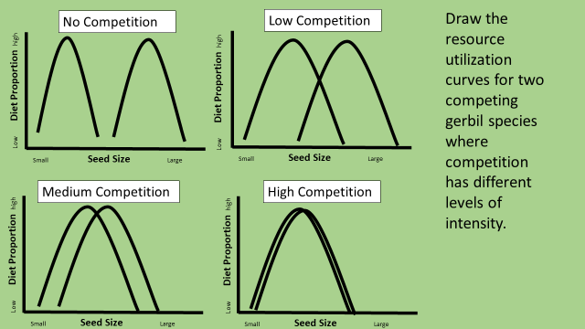
Example Worksheets
I
I ,II, III
II & IV
I & II
I & II

Slide 27
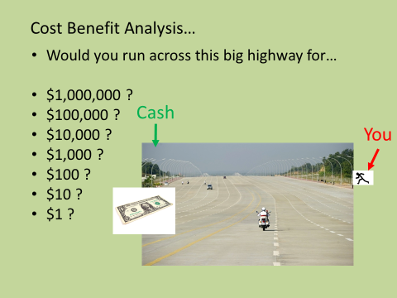
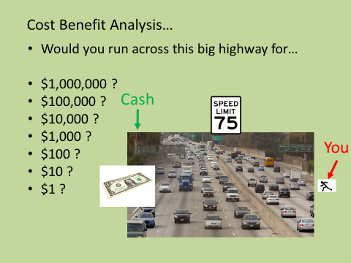
Example: Large Activities
H_{NET} = H_{AR} – H_{RR} ± H_{COND} ± H_{CONV} – H_{EVAP} + H_{MET}
II & IV
I & II
I & III
IV
I, II & III
Biogeography Simulation
II & IV

Slide 28
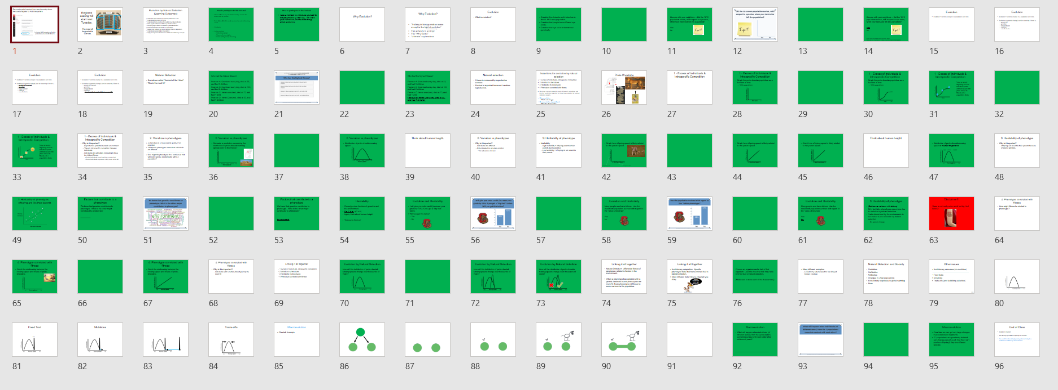
*30-60% of lecture time (dark slides = active learning)
*5 to 14 active events
*1 to 10 min. per event.

Slide 29
Coverage
(~% time in lecture)
Lesson

Slide 30
All 4 4DEE dimension can be addressed in lecture through active learning
Lecture
Active Learning
Active Learning

Slide 31
4DEE & Active Learning Outside of Class
Out of class materials can have similar 4DEE coverage as lecture.

Slide 32
Structure to implement active learning
For each lecture, students…
have a pre-lecture interactive reading assignment
attend the lecture and participate in active learning
work on a post-lecture interactive learning assignment

Slide 33
For how long have we had explicit active learning before lectures?
~1000 years
~100 years
~50 years
~25 years
~10 years
~5 years
There is not active learning before lectures

Slide 34
For how long have we had explicit active learning before lectures?
~1000 years
~100 years
~50 years
~25 years
~10 years
~5 years
There is not active learning before lectures
There is not really a correct answer!

Slide 35
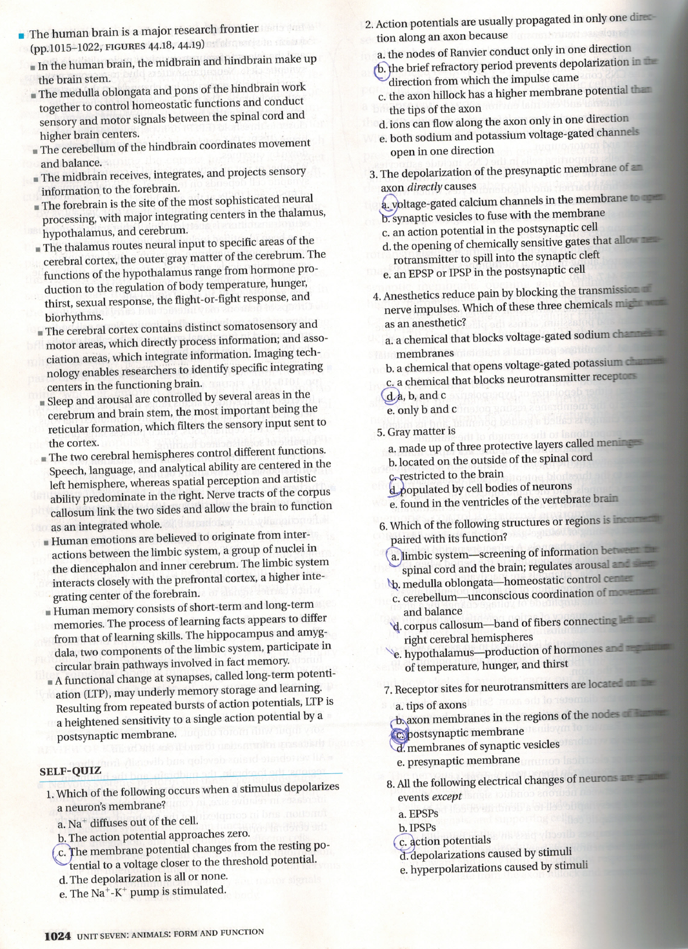
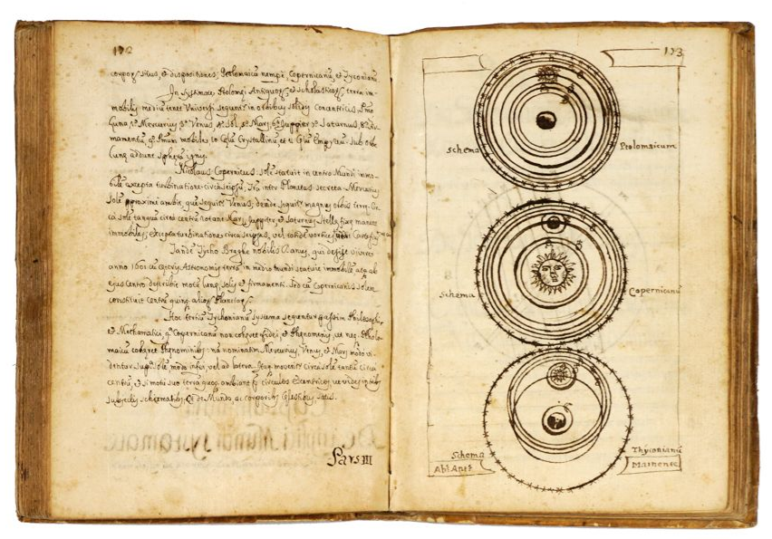
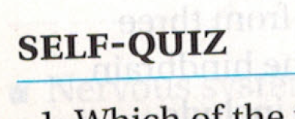
Active Learning Before Lectures
Notes:
*Old text books, lucky to have pictures!
*Most common use of texts is now for reading before lectures , have recognized the importance of active reading for decades (Photo from campble).
But now we have tools that can help us with this.

Slide 36
Pre-lecture active assignments
Formative
Unlimited time
Open book
Graded for accuracy or completion
Logistics
5%-10% of total grade
Due before lecture
Assignment
5-20 questions OR 15 to 75 min.
Typically, lower-level Blooms
Feedback for each question
Auto-graded
Advantages
Students are held accountable for reading
Students are prepared for class
Frees up more time in lecture for active learning
Students attain basic knowledge and understanding which helps them achieve learning objectives
Students report report that these assignments are valuable for their learning!

Slide 37
Active Learning Before Lectures
Many ways to implement
Interactivity in a digital textbook (eg SimBio Ecology)
Paper homework
Using an LMS
Using publisher resources

Slide 38
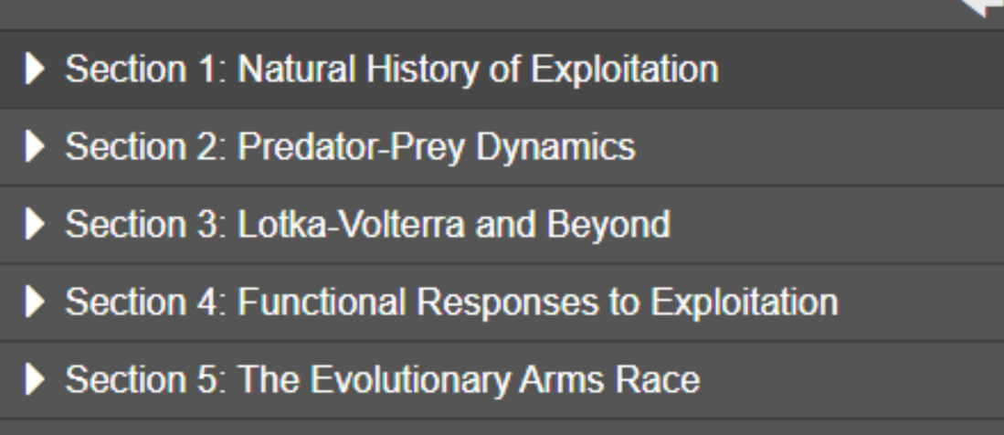
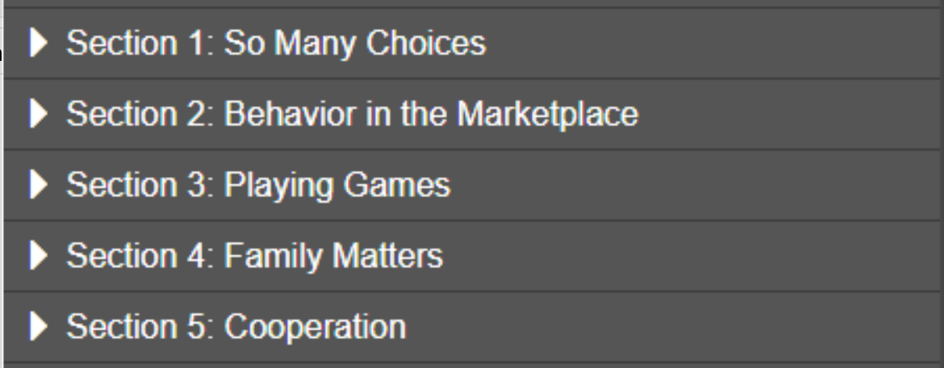
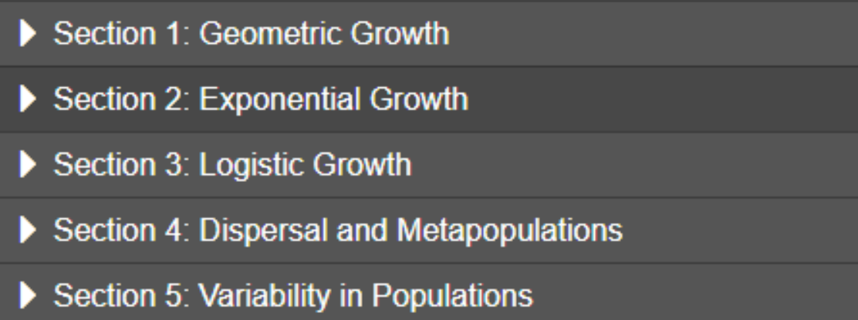
Before Lecture
Sections 1, 2, and 3
Section 1
S1(pp1-18), S3(pp1-12), S5(pp1-7)
Sections 1, 2, and 3

Slide 39
Active Learning After Lectures
Many ways to implement
Using traditional homework
Using an LMS
Using publisher resources (big advantages)

Slide 40
Should active learning after lecture be higher-level or lower-level blooms?
Higher
Lower

Slide 41
Should active learning after lecture be higher-level or lower-level blooms?
Higher
Lower
There is not really a correct answer!

Slide 42
Post-lecture active assignments
Formative
Unlimited time
Open book
Graded for accuracy (forgiving)
Very targeted toward learning objectives
Logistics
Covers book and lecture content, sometimes extends it.
Due before next lecture
5%-15% of total grade
Assignments
Variable number of questions/activities or duration.
Higher-level Blooms
Address both content and skills
Feedback for each question
Auto-graded
Advantages
Shows me, as an instructor, where students are struggling
Students are given the opportunity to self assess
Reinforces concepts and skills so students are better able to achieve learning outcomes
Students get instant/adaptive feedback
Students report that these assignments are valuable and that they like them: “I know where I need to learn more”, “free studying”, “I enjoy working on these with my friends”.

Slide 43
After Lecture

Slide 44
Does it work?...

Slide 45
Does it work?... Generally, Yes.

Slide 46
Teaching Ecology the ESA way: Using the 4DEE framework to guide active learning in ecology classes
Dr. Justin R. St. Juliana
Department of Ecology and Evolutionary Biology
Cornell University
Learning Objectives:
Know Dimensions of the 4DEE framework.
Understand the 4DEE framework.
Consider how active learning can be used to increase the coverage of 4DEE related learning objectives in the classroom.
Consider how resources like (SimUText) can be used to actively cover 4DEE related learning objectives outside the classroom before and after lecture.
Engage in a discussion at the intersection of: 4DEE, active learning, and course resources.

